Slide 1
Introduction & Insights
MomentFeed

Slide 2
Topics
Introduction
Key Concepts
Market • Buyer • CBI Analysis
Impact Tree™
Intro to Discovery

Slide 3
Section 1 Introduction

Slide 4
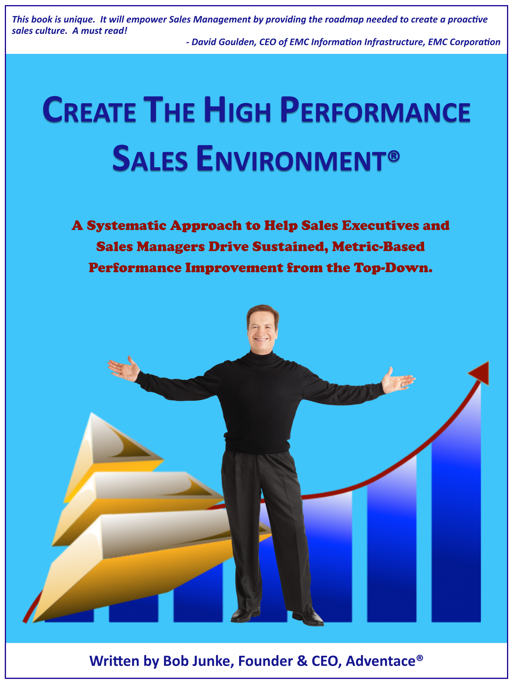
Introduction to Adventace®
Objective: Help clients Create the High Performance Sales Environment®
Adventace Methods™, Our Holistic Methodology
Sales
Execs
Senior
Sales Managers
Adventace SMS™, Our Salesforce app
2015: Top 20 Upcoming Solution Provider
2016: Top 50 Most Powerful Technology Provider
Performance Metrics
Proactive Management
Sales Managers
Sales People
Best Selling Book, Create the High Performance Sales Environment™

Slide 5
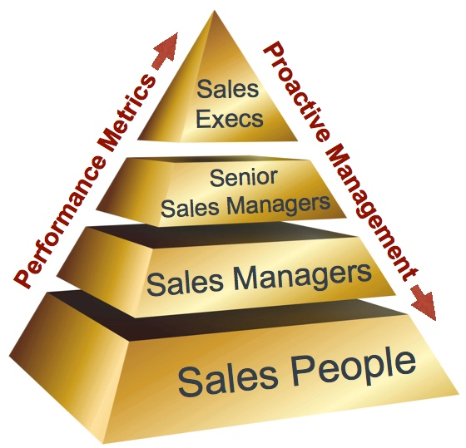
Adventace Methods™ Sales Programs
Selling Point Solutions™
Selling Complex Solutions™
Methodology
Complex sales calls and sales cycles
Visionary Selling™
Propel buyers to envision how they can boldly take their business where it has never gone before

Slide 6
High Performance Sales Management
Four Pillars
of Sales Management
1st Level Sales Management
Opportunity Assessment & Management
Pipeline Management
Seller Development
Continuous Improvement

Slide 7
Client Success: SolidWorks
Seller Performance Comparison Based on Certification
Product | Certification
 | Level 1 | Level 2
Design | 215% | 375%
Simulation | 203% | 389%
Manage | 200% | 647%
Communications | 266% | 607%
These metrics are quite compelling, and reveal the value of and retention from the certification programs.
- SolidWorks Worldwide Sales Certification Manager

Slide 8
Section 2 Key Concepts

Slide 9
CBI’s Drive Buyers… and Sales Cycles
A Critical Business Issue (CBI) may be:
A business goal or objective (e.g., profit growth, inventory reduction, cash flow improvement) the buyer needs help with
Something imposed from the outside (e.g. regulation, deregulation)
A problem recognized internally and currently causing someone emotional and/or monetary impact (e.g. VP of Sales seeing sales slippage)
Someone is judged in the performance of their job function!
The CBI is always personal ….
impacting different job titles differently

Slide 10
The Four Levels of Need
Level |  | Characteristic
1 | Background CBI | Buyer is not currently attempting to resolve a CBI. The buyer is aware that the CBI exists but is not seeking a resolution to it (i.e., the buyers keep it in the “background” of his/her mind).
2 | Foreground CBI | Buyer admits their CBI to the seller, usually characterized by a complaint. However, buyer does not envision a solution. Seller and buyer identify causes of CBI.
3 | Solution | Buyer is able to envision one or more capabilities they need, which taken together represents, in their mind, a solution to their CBI. The buyer must see how the capabilities will make the CBI go away. Now they must be taken to the fourth level, proof.
4 | Proof | The seller must be able to prove that he/she has the capabilities the buyer needs to help the buyer solve their CBI. When completed to the buyer’s satisfaction, the buyer values the seller’s solution.

Slide 11
Level (1, 2) Vs. Level (3, 4) Needs Where Should You Look to Prospect / Penetrate Accounts?
Some trigger …
Level 1 or 2
Not Actively Looking
90%
Level 3 or 4
Actively Looking
10%
Make dust.
Don’t eat dust.

Slide 12
Not Yet Looking…But Should They Be? Typical Level 1 & 2 Needs in Restaurant Industry
Job Title/Function | Potential Critical Business Issues
Head of Marketing | Unable to achieve local store revenue targets Online programs are less effective as customers go mobile
Head of SEO | Not achieving Google ranking goals (coupled with constant algorithm changes) Unable to stay ahead of key competitors Can’t effectively manage search optimization on social media
Head of Digital Advertising | Under pressure to drive new revenue from local stores Allocating scarce advertising resources Not reaching mobile customers using same online programs
Head of Customer Relations | Can’t keep up with reviews impacting brand because they’re in so many places Unable to source and react quickly to negative reviews
Head of Social | Fragmented customer engagement across many channels and locations Can’t keep up with growing and changing base of social networks
Head of Technology | Our technologies are not mobile-enabled Can’t rapidly deploy technology to meet omni-channel demand of customers
Head of Sales | Not achieving revenue targets
Head of Finance | Need to reduce costs in environment of increasing departmental demand New company growth initiatives not meeting performance measures
Notes:
NOTE:
We need to build a list of all those buyers we typically sell to and the CBIs they might face.
Note CBIs are personal to a specific job title.
Different roles have different problems
Note also to sell somewhere between 1-5 seats in 0-3 months .... the definition of a 1503 sale .... we probably only need to sell to a small selection of the wider organisation.

Slide 13
Building a Level 3 Solution Objectives of Need Development During a Sales Call
Job-Specific Critical Business Issues
Cause
Cause
Cause
Capability
Capability
Capability
From the Buyer’s Perspective:
Solution = Capability₁ + Capability₂ + Capability₃
Solution

Slide 14
Level 4 Proof of Capabilities
Job-Specific Critical Business Issues
Cause
Cause
Cause
Capability
Capability
Capability
Proof
Proof
Proof
Keep your product in your pocket until it’s time for proof!

Slide 15
The Power Line
1st Level Sales Management
Buyers Above the Power Line
Buyers Below the Power Line

Slide 16
Buyers “Below the Power Line”
Do Not Have Power to Buy
Shield Sellers from Above the Line Buyers
May Favor the Competition

Slide 17
Buyers “Above the Power Line”
Investment in Their Business
Power to Buy or Directly Participate
Grant Access to Other “Above the Power Line” Buyers
Agree to Steps Leading to Buy Decision (aka, Action Plan)

Slide 18
A/B Ratio
1st Level Sales Management
A Opportunity
A/B Ratio
B Opportunity

Slide 19
A / B Ratio
Parameter | Common Starting Point | After 1 Quarter | After 2 Quarters | After 3 Quarters
A/B Ratio | 1/8 | 1/1 | 4/1 | 6/1
Time Wasted Dealing with Buyers Who Cannot Buy | 40% | 20% | 10% | Nominal

Slide 20
Section 3 Market • Buyer • CBI Analysis

Slide 21
Big Picture of Sales Methodology
Opportunity Identification
1. Prospecting
2. Behavior Alignment
SALES CALL
SELL CYCLE
Execute Activities
(To qualify & control sell cycle)
Stage 2 of Buying Model
Call on others above power line
Determine CBI’s & capabilities
Stage 3 of Buying Model
Proof
Value justification
Proposal Discussion
Stage 4 of Buying Model
Gain approval
Stage 5 of Buying Model
Initiate implementation
3. Call Introduction:
Establish Goal of Call
Provide Competency Message
4. Discovery
(Solution Evolution
Solution Re-Evolution)
5. Determine Impacts
“Causes & Effects” across
those involved
6. Determine Power Level of Buyer
7a. Promoter
Negotiate proof for access to power
7b. Power Promoter
Qualify buying process
- Define Action Plan
8a. Send Letter of Understanding to Promoter
8b. Send Letter of Understanding to
Power Promoter

Slide 22
Opportunity Identification
Opportunity Identification
1. Prospecting
2. Behavior Alignment
SALES CALL
SELL CYCLE
Execute Activities
(To qualify & control sell cycle)
Stage 2 of Buying Model
Call on others above power line
Determine CBI’s & capabilities
Stage 3 of Buying Model
Proof
Value justification
Proposal Discussion
Stage 4 of Buying Model
Gain approval
Stage 5 of Buying Model
Initiate implementation
3. Call Introduction:
Establish Goal of Call
Provide Competency Message
4. Discovery
(Solution Evolution
Solution Re-Evolution)
5. Determine Impacts
“Causes & Effects” across
those involved
6. Determine Power Level of Buyer
7a. Promoter
Negotiate proof for access to power
7b. Power Promoter
Qualify buying process
- Define Action Plan
8a. Send Letter of Understanding to Promoter
8b. Send Letter of Understanding to
Power Promoter

Slide 23
Think Like Your Buyers to Identify Opportunities
External Business Issues
Internal Business Issues
Role-
Specific
CBI’s
Role-
Specific
CBI’s
Role-
Specific
CBI’s
Role-
Specific
CBI’s
Role-
Specific
CBI’s
Notes:
You’ve seen this before as well .... In ACE foundation
By understanding the external business issues facing a company because it is in a particular vertical market you can accurately hypothesise the internal business pressures facing all companies in that vertical.
From those internal business issues we can accurately hypothesise the role specific CBIs facing people operating within those organisations

Slide 24
Restaurant Industry
External Business Issues
Continued growth in consumer use of mobile devices along with impact on purchase decisions.
Complex, growing, and rapidly changing social media channels
Upcoming Generation Z consumers (i.e., tech and social savvy)
Consumer trends change rapidly
Notes:
Here is an example for our example account group ... Large, Medical Devices companies who already have some seats of CAD
This was quickly and easily completed from our internet analysis ... 30 mins tops!

Slide 25
Resulting Internal Business Issues
Internal Business Issues
Keeping up with rapidly changing consumer trends
How do we create better engagement and a better relationship?
Provide restaurants with a localized brand and identity to talk to the customer
Staying ahead of competition locally (rankings, channels, etc.)
Rapid, proactive, personalized response to consumer issues
Improve ROI with same spend
Deliver your message at the moment
Increase YOY same store sales
Notes:
The last page follows through to these internal business issues
All medical devices companies need to:
Work with healthcare industry to develop new devices
Minimize development cost on devices which do not prove viable
Be first to market
Be sure of regulatory compliance
And develop devices which are easily mass produced at minimum cost and are smaller / lighter / cheaper etc than their competitor’s products

Slide 26
Job-Specific CBI’s
Role-
Specific
CBI’s
Role-
Specific
CBI’s
Role-
Specific
CBI’s
Role-
Specific
CBI’s
Role-
Specific
CBI’s
Job Title/Function | Potential Critical Business Issues
Head of Marketing | Unable to achieve local store revenue targets Online programs are less effective as customers go mobile
Head of SEO | Not achieving Google ranking goals (coupled with constant algorithm changes) Unable to stay ahead of key competitors Can’t effectively manage search optimization on social media
Head of Digital Marketing | Under pressure to drive new revenue from local stores Allocating scarce advertising resources Not reaching mobile customers using same online programs
Head of Customer Relations | Can’t keep up with reviews impacting brand because they’re in so many places Unable to source and react quickly to negative reviews
Head of Social | Fragmented customer engagement across many channels and locations Can’t keep up with growing and changing base of social networks
Head of Technology | Our technologies are not mobile-enabled Can’t rapidly deploy technology to meet omni-channel demand of customers
CEO | Not achieving revenue targets
Head of Finance | Need to reduce costs in environment of increasing departmental demand New company growth initiatives not meeting performance measures
Use to Build Impact Tree™

Slide 27
Restaurant Industry Impact Tree™ #1
CEO
CBI: | Not achieving revenue targets
Cause 1: | Unable to achieve same store sales growth
Head of Marketing
CBI: | Unable to achieve same store sales growth
Cause 1: | Need new revenue sources
Cause 2: | Poor Google Ranking
Cause 3: | Bad reviews impact local customer satisfaction
Head of Digital Marketing
CBI: | Unable to achieve new revenue source goals
Cause 1: | Unable to project local image
Cause 2: | Fragmented Customer Engagement
Customer Relations
CBI: | Bad reviews impact local customer satisfaction
Cause 1: | Local managers don’t always follow up with customer
Cause 2: | Bad local reviews on social media go unanswered
Head of SEO
CBI: | Poor Google Ranking
Cause 1: | Unable to optimize search on social media
Social Media
CBI: | Fragmented Customer Engagement
Cause 1: | Unable to manage so many channels

Slide 28
How are Impact Trees Utilized?
Planning through Prospecting
Territory and/or account planning
Opportunity identification
Outcome is Impact Trees™
Impact Trees represent the full opportunity to be pursued
Build prospecting tools personalized to the high probability CBI’s impacting each buyer on the Impact Tree
Significantly expansion of buyers to call on

Slide 29
How are Impact Trees Utilized?
Sales Call Qualification
Identify key impacted individuals
Expand scope of opportunity
Helps determine power level of the buyer you are calling on:
If below negotiate for access
If above discuss & agree to sequence of events leading to buy decision
Conveys understanding of complete solution for buyers

Slide 30
How are Impact Trees™ Utilized?
Manage/Control Sales Cycle
Integrate buying committee to solve broader set of issues
Increases probability of finding money
Increases desire at top to solve problem
Many opportunities “die” because ultimate decision maker does not see what’s in it for their organization
Increases probability of win
SELL CYCLE
Ultimate Decision Maker
Execute Activities
(To qualify & control sell cycle)
Stage 2 of Buying Model
Call on others above power line
Determine CBI’s & capabilities
Stage 3 of Buying Model
Proof
Value justification
Proposal Discussion
Stage 4 of Buying Model
Gain approval
Stage 5 of Buying Model
Initiate implementation
Financial Decision Maker
Above the Power Line Buyer
Power Promoter
Promoter

Slide 31
Section 4 Discovery

Slide 32
Discovery
Opportunity Identification
1. Prospecting
2. Behavior Alignment
SALES CALL
SELL CYCLE
Execute Activities
(To qualify & control sell cycle)
Stage 2 of Buying Model
Call on others above power line
Determine CBI’s & capabilities
Stage 3 of Buying Model
Proof
Value justification
Proposal Discussion
Stage 4 of Buying Model
Gain approval
Stage 5 of Buying Model
Initiate implementation
3. Call Introduction:
Establish Goal of Call
Provide Competency Message
4. Discovery
(Solution Evolution
Solution Re-Evolution)
5. Determine Impacts
“Causes & Effects” across
those involved
6. Determine Power Level of Buyer
7a. Promoter
Negotiate proof for access to power
7b. Power Promoter
Qualify buying process
- Define Action Plan
8a. Send Letter of Understanding to Promoter
8b. Send Letter of Understanding to
Power Promoter

Slide 33
Solution Evolution: 3 Part Process
Identify Critical Business Issue
B to B Questions
Goal Analysis
Personal CBI Analysis
Discovery
Causes
Capabilities
Buyer’s Choice
CBI
Confirmation
CBI & Causes
Capabilities & Value

Slide 34
Identify Critical Business Issue
Functional Role / Vertical: Head of Digital Advertising / Restaurant Industry Potential CBI: Unable to increase same store revenues
Business Questions: How do you determine the ROI on ad spend at the store level? Do you know how much mobile presence influences your offline revenue? Our studies with clients consistently show that their digital footprint is >1,000% more impactful than their brand presence. How do you maximize the impact of your digital footprint?
Goal Analysis: What are your key goals and objectives for the next 12 months? Which are you successfully achieving? Not achieving? What are your goals re the measurable lift in customers reached through digital advertising? How do you measure it? Return? Reliance on mobile vs. brand advertising? What are your ROI goals on ad spend? What’s actual?
Personal CBI Analysis: How do you target local consumers? How do you build your image of being a neighborhood restaurant to consumers who are near your locations? How do you interact with your customers better at a local level? Google and Facebook algorithms rate this very highly. How do you outrank the competition when they are looking for something to eat or drink? How do you stay ahead of the competition in garnering local consumer loyalty?
Buyer’s Choice Questions: The top three difficulties we are hearing from other digital advertising executives are: Difficulty allocating scarce advertising resources The confusing array of platform services available to help you get to mobile customers Inability to work with store managers/franchisees to attract customers? Are you facing any of these issues?
Measure CBI and Transition to Discovery: What is the impact on your business because of [CBI]? Why are you experiencing the issue of [CBI]?

Slide 35
Solution Evolution: Discovery
Identify Critical Business Issue
Cause 1 | Capability 1
Cause 2 | Capability 2
Cause 3 | Capability 3
Discovery
Causes
Capabilities
Confirmation
CBI & Causes
Capabilities & Value

Slide 36
Selling Tenet: Diagnose Before You Prescribe
Like a doctor talking to a patient
Ask intelligent questions to better understand the reasons for the problem
Seller:
Better understands the problem
Better understands the capabilities needed
Buyer
Builds trust in the seller
Better understands the capabilities needed

Slide 37
Causes
“We never ask a question that we don’t already know the answer to!”
- Dewey, Cheatem, and Howe Law Firm
Cause
Capability
Feature

Slide 38
Capability Statements Event - Target - Action (ETA)
Functional Role: Head of Digital Marketing
CBI: Unable to increase same store revenues
Cause 1: Today’s ads reflect your brand page and don’t impact the mobile consumer enough when they’re making dining decisions
How would the Head of Digital Marketing want to function tomorrow?
Event | A realistic situation, event, or plausible emergency that would occur today and result in the “cause” | When developing an ad
Target | Someone in the buyer’s organization who would take action | You
Action | What action should they take or how would they want to operate tomorrow ? Be as specific and ‘visual’ as possible. | Were able to leverage the digital presence of each of your stores so when a mobile customer does a search to select a restaurant, they would see an ad that looks like it came directly from the store nearest to them, and could include locally relevant information such as the store’s address, phone number, and even content generated by other consumers?
Notes:
38
38
38
Teach and explain for Cause 3

Slide 39
Capability Statements Event - Target - Action (ETA)
Functional Role: Head of Digital Marketing
CBI: Unable to increase same store revenues
Cause 1: Today’s ads reflect your brand page and don’t impact the mobile consumer enough when they’re making dining decisions
How would the Head of Digital Marketing want to function tomorrow?
Event | A realistic situation, event, or plausible emergency that would occur today and result in the “cause” | When developing an ad
Target | Someone in the buyer’s organization who would take action | You
Action | What action should they take or how would they want to operate tomorrow ? Be as specific and ‘visual’ as possible. | Were able to leverage the digital presence of each of your stores so when a mobile customer does a search to select a restaurant, they would see an ad that looks like it came directly from the store nearest to them, and could include locally relevant information such as the store’s address, phone number, and even content generated by other consumers?
Notes:
39
39
39
Teach and explain for Cause 3

Slide 40
Solution Evolution: Confirmation
Identify Critical Business Issue
Discovery
Causes
Capabilities
Summarize CBI and Causes | Summarize Capabilities (= Solution)
Confirmation
CBI & Causes
Capabilities & Value

Slide 41
Solution Evolution Knowledge Tool
Functional Role / Vertical: Head of Digital Advertising / Restaurant Industry Potential CBI: Unable to increase same store revenues
1. CBI IDENTIFICATION Business Questions: How do you determine the ROI on ad spend at the store level? Do you know how much mobile presence influences your offline revenue? Our studies with clients consistently show that their digital footprint is >1,000% more impactful than their brand presence. How do you maximize the impact of your digital footprint? Goal Analysis. To complete projects on time and budget: Goal Analysis: What are your key goals and objectives for the next 12 months? Which are you successfully achieving? Not achieving? What are your goals re the measurable lift in customers reached through digital advertising? How do you measure it? Return? Reliance on mobile vs. brand advertising? What are your ROI goals on ad spend? What’s actual? Personal CBI Analysis: How do you target local consumers? | How do you target local consumers? How do you build your image of being a neighborhood restaurant to consumers who are near your locations? How do you interact with your customers better at a local level? Google and Facebook algorithms rate this very highly. How do you outrank the competition when they are looking for something to eat or drink? How do you stay ahead of the competition in garnering local consumer loyalty? Buyer’s Choice Question: The top three difficulties we are hearing from other digital advertising executives are: Difficulty allocating scarce advertising resources The confusing array of platform services available to help you get to mobile customers Inability to work with store managers/franchisees to attract customers? Are you facing any of these issues? Measure CBI and Transition to Discovery: What is the impact on your business because of [CBI]? Why are you experiencing the issue of [CBI]?
2. DISCOVERY (Causes): Are you having difficulty… You have incorrect digital location data? Could that make various locations invisible? How many locations? When an online customer searches for a nearby restaurant, could they travel to a location where you had no presence, thus no purchase and and an angry customer? | 2. DISCOVERY (capabilities): Would it help if… Every one of your locations’ digital information could be reviewed and, where necessary, corrected then submitted to the networks and data aggregators, so that when an online consumer searches for a nearby restaurant, they would be provided with the correct digital identity for that location?
Today’s ads reflect your brand page and don’t impact the mobile consumer enough when they’re making dining decisions? (We have found that 50% of offline spend is influenced by mobile.) | When you develop an ad, you were able to leverage the digital presence of each of your stores so when a mobile customer does a search to select a restaurant, they would see an ad that looks like it came directly from the store nearest to them, and could include locally relevant information such as the store’s address, phone number, and even content generated by other consumers?
Bad reviews or complaints about a store on social media are not followed up on by the manager directly with the customer and/or go unanswered on social media? Impact? | You were able to run a daily report that showed which restaurants had the best reviews and which had the worst, and then armed with that information, you had a great deal of flexibility to fix problems. Ex: Respond as if you were the manager directly, ensuring immediate follow up. Flag 1 or 2 star reviews 2 days old to see if there was follow up. Hold managers accountable or forward the link to field marketing for follow up.
3. CONFIRMATION: So the issue you’re having is (repeat CBI) & causes are _______. Is that accurate? | 3. CONFIRMATION: If you had the following capabilities…Could you solve (repeat CBI)?
Notes:
41

Slide 42
Q & A

Slide 43
See You on Wednesday!

